Slide 1
“building and preserving Alaska’s Future”
Corps of Engineers
Regulatory Program Overview
Ellen Lyons
Regulatory Division
U.S. Army Corps of Engineers – Alaska District
February 14, 2018
Notes:
Amanda Andraschko will speak more broadly on the Corps of Engineers at the District level…my portion of the Corps presentation will focus specifically on the Regulatory Program.

Slide 2
Agenda Items
• USACE Mission & Permit Authorities
• Jurisdiction
• Types of Permits
• Permit Evaluation Process

Slide 3
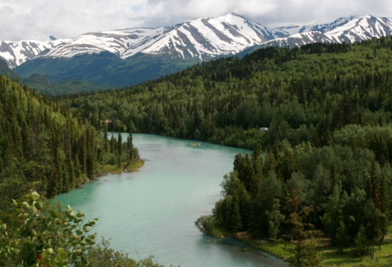
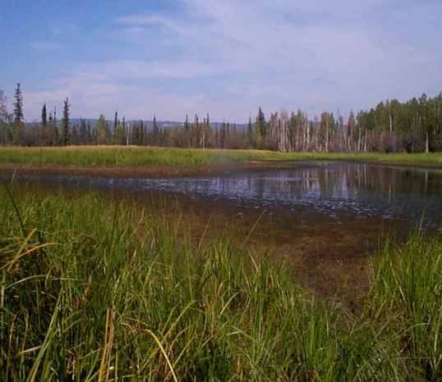
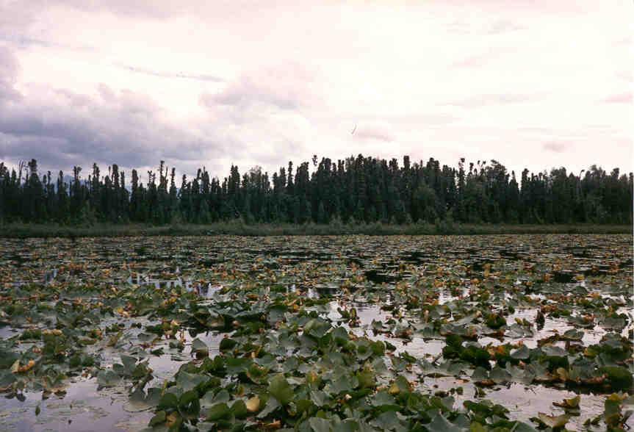
Regulatory Mission
To protect the Nation’s aquatic resources, while allowing reasonable development through fair, flexible and balanced permit decisions.
Notes:
The Corps is literally the nation’s environmental engineers…in all Corps programs. One of the most important programs and one that touches a substantial proportion of all projects that get constructed in the nation, the Regulatory Program strives to do exactly as our federal mission states: to make permit decisions that fairly and flexibly balance protection of aquatic resources with allowance of reasonable development.

Slide 4
ALASKA DISTRICT
U.S. ARMY CORPS OF ENGINEERS
LARGEST DISTRICT IN THE NATION (GEOGRAPHICALLY)
1/5th the size of the lower 48 states
33,904 miles of coastline
15 million miles of potentially navigable waterways
3 million lakes
43% of the state is wetlands
220 million acres of wetlands and other waters
BUILDING STRONG®
4

Slide 5
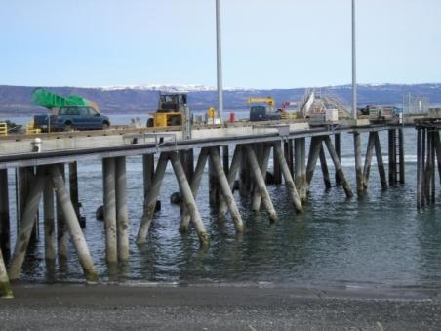
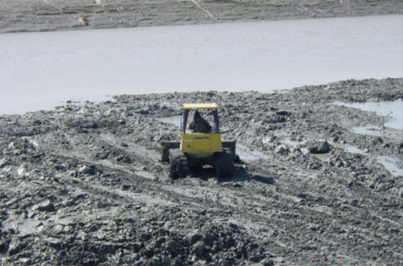
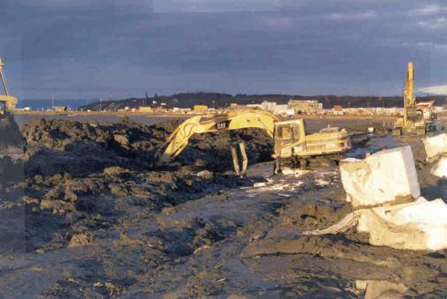
Rivers and Harbors Act of 1899
Section 10 – Navigable Waters
USACE is authorized to issue permits for structures or work
affecting the course, condition, location or capacity of the navigable
waters of the United States.
Waters subject to tidal ebb and flow up to MHW; and/or
Waters presently used, or have been used in the past, or may be susceptible for use to transport interstate or foreign commerce.
Primary Goal: Maintain navigation
Structures and/or Work
Dredging/Fill
Excavation

Slide 6
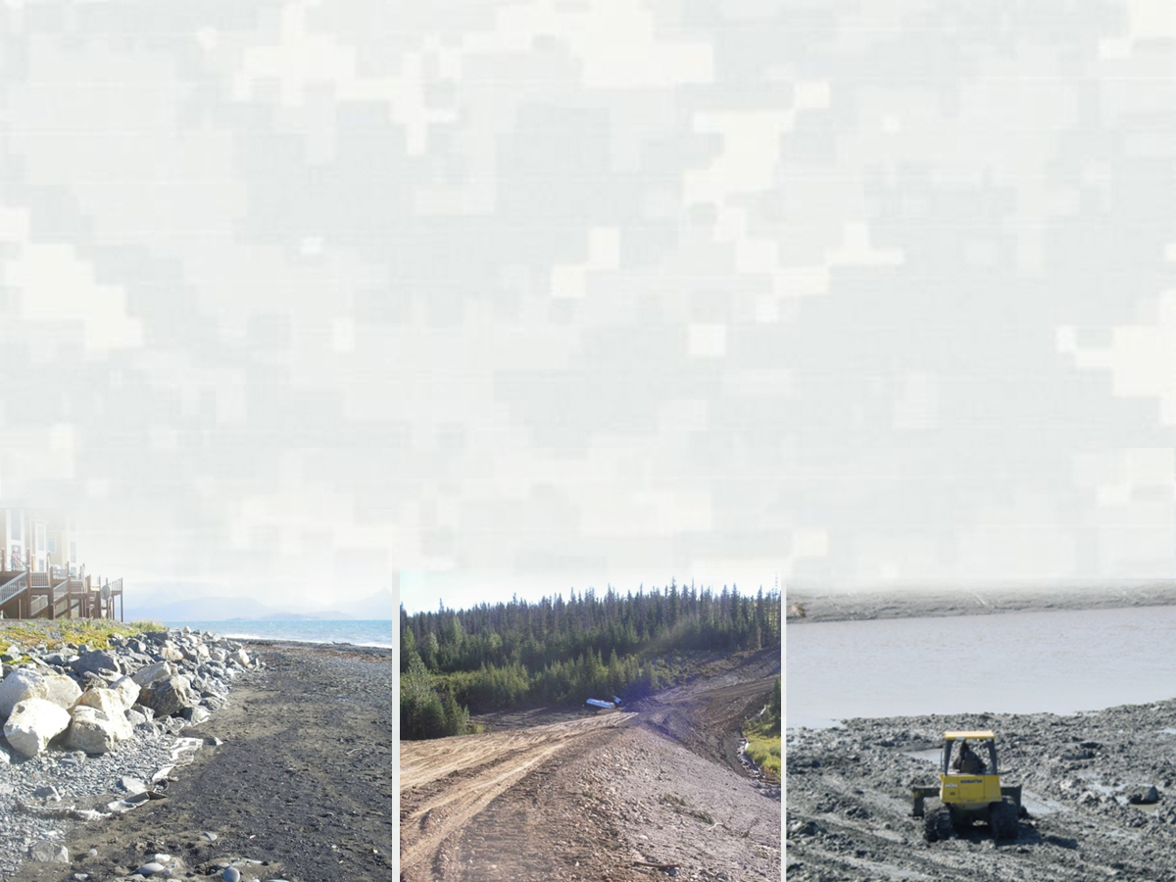
CLEAN WATER ACT SECTION 404
USACE is authorized to issue permits for the discharge/placement of dredged or fill material into waters of the United States
All navigable waters
Rivers, tributaries, lakes, bogs, marshes, most wetlands*, etc.
Wetland Criteria:
- Soils
Vegetation
Hydrology
Primary Goal: Restore and maintain the physical, chemical, and biological integrity of the nation’s waters

Slide 7
USACE Permit Authorities
Marine Protection, Research
and Sanctuaries Act of 1972
(Section 103)
Ocean waters outside of territorial seas
Transportation of dredged material for the purpose of disposal into ocean waters

Slide 8
TYPES OF PERMITS
Nationwide General Permits
Issued by USACE Headquarters; districts add regional conditions
Established through public notice and comment
Valid for 5-year period; currently 54 types
Shorter processing time than Individual Permits (<60 days)
Regional General Permits
Issued at the district level through public notice and comment
Valid for 5-year period; currently 7 types
Minimal adverse effects to the aquatic environment
Shorter processing time than Individual Permits (<60 days)
Other Permit Types
Letter of Permission: In Alaska, an expedited review, applicable to certain
activities not involving fill in navigable waters (Section 10)
Standard Individual Permits
Public notice on specific project; 90-120+ day processing times
Activities with potentially more than minimal impact (outside general permit thresholds)
8

Slide 9
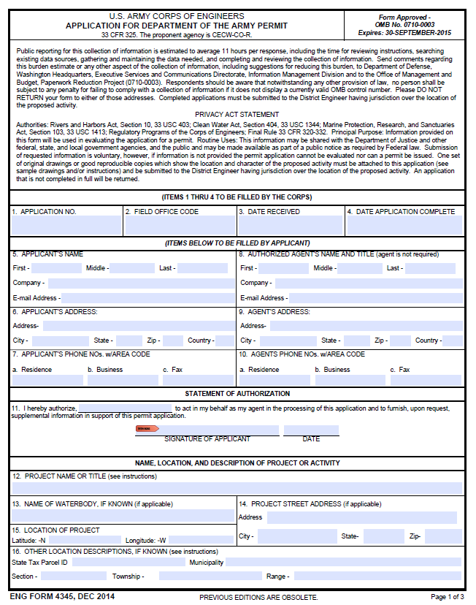
Permit Application Content and Processing
Completed Application Form
Project purpose and description
Proposed impacts on drawings
Mitigation statement
http://www.poa.usace.army.mil/Missions/
Regulatory/Permitting-Section-Homepage/
9

Slide 10
Permit Application Processing
USACE will first determine presence of jurisdiction,
then which type of permit the application requires…
For Standard Individual Permits: Upon receipt of a “complete” application, a 15-30 day public comment period begins within 15 days
10

Slide 11
Permit Application Processing
A Public Notice serves multiple purposes…
…it notifies the general public that a project
is proposed…
…specifically notifies adjacent property owners…
…initiates the request for state water quality certification (Clean Water Act Section 401)
…notifies commenting agencies and requests any
feedback relevant to their areas of expertise/authority
11
Notes:
USACE has a general PN mailing list (electronic) as well as posting all PNs on web page.

Slide 12
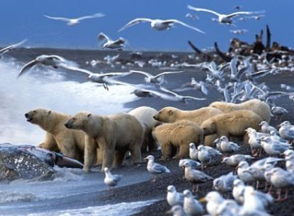
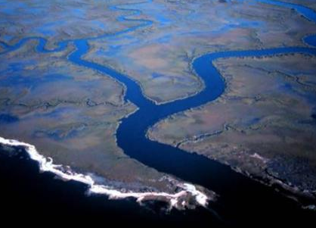
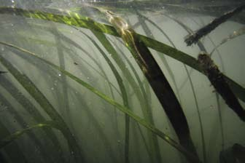
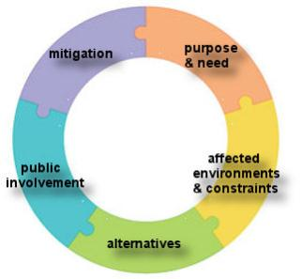
OTHER LEGAL REQUIREMENTS
ENDANGERED SPECIES ACT
FISH & WILDLIFE COORDINATION ACT
WATER QUALITY CERTIFICATION
MAGNUSON-STEVENS FISHERY CONSERVATION & MANAGEMENT ACT
NATIONAL HISTORIC PRESERVATION ACT
NATIONAL ENVIRONMENTAL POLICY ACT
Notes:
Coastal Zone Management – ask Mike S. what happened to it?

Slide 13
Permit Evaluation Process
In a nutshell:
To identify and permit the least environmentally damaging
practicable alternative that meets the project purpose.
Compliance with
404(b)(1) Guidelines
Public Interest Review
The entire USACE application review and decision process
occurs in tandem and in compliance with the NEPA process,
captured in CDD or ROD
Permit Decision
13
Notes:
Reference: 33 CFR 320.4

Slide 14
404(b)(1) Guidelines: Restrictions on Discharge
No discharge of fill material shall be permitted if …
there is a practicable alternative to the proposed discharge which would have less adverse impact on the aquatic ecosystem
it violates State water quality or toxic effluent standards; jeopardizes the continued existence of an endangered or threatened species; or violates the protection of any marine sanctuary
it will cause or contribute to significant degradation of the waters of the United States
appropriate and practicable steps have not been taken which will minimize potential adverse impacts on the aquatic ecosystem
Notes:
The Guidelines constitute the substantive environmental criteria used in evaluating Section 404 activities. Purposes is to restore and maintain the physical, chemical and biological integrity of waters of the U.S. through control of discharges of dredged or fill material. 40 CFR 230.1(a)

Slide 15
USACE regulations require the determination whether an
issued permit would be contrary to the public interest…
33 CFR 320.4
Public Interest Review
Factors
wetlands water quality land use
flood hazards floodplain values economics
conservation mineral needs energy need
historic properties - water supply and conservation
fish/wildlife values - food and fiber production
navigation - shore erosion and accretion
safety - considerations of property ownership
aesthetics - general environmental concerns
recreation - needs and welfare of the people
15

Slide 16
National Environmental Policy Act
Encourages and facilitates public involvement in federal decisions which affect the quality of the human environment.
Requires agencies to identify and analyze reasonable alternatives to proposed actions …
Requires federal agencies to analyze adverse effects of their actions upon the quality of the human environment.
404(b)(1) Guidelines has a substantive requirement that ONLY
the least environmentally damaging practicable alternative (LEDPA)
can be authorized.
NEPA requires public involvement, analysis of alternative and
disclosure of effects. NEPA does not require selection of the most
environmentally prefereable alternative.
Notes:
NEPA

Slide 17
Mitigation – What is it?
Avoidance - avoid impacts to Waters of the United States, including wetlands, whenever possible
Minimization - minimize impacts that cannot be avoided
Compensation - may be required to compensate for any impacts that remain after avoidance and minimization
Create
Restore
Rehabilitate
Preserve
Mitigation Bank
In-Lieu Fee
Permittee-Responsible
17
Notes:
Mitigation is used to ensure a project is not contrary to the public interest. …sufficient to replace lost aquatic resource functions to the extent practicable. 2008 Mitigation rule (33 CFR 332) has detailed standards and requirements for wher and how compensatory mitigation is to be one. DOES NOT dictate WHEN compensatory mitigation is required.

Slide 18
Final Words
The Corps is neither an opponent nor a proponent of the applicant’s proposal 33 CFR 325 Appendix B
33 CFR 325, Appendix B:
Decision options available to the district engineer…
Issue the permit
Issue with modifications or conditions
Deny the permit

Slide 19
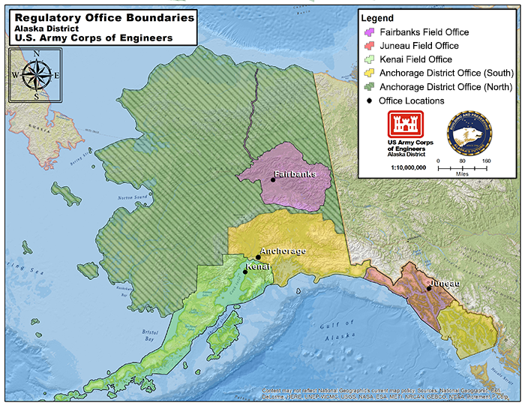
Anchorage District Office
2204 3rd Street JBER, Alaska 99506-0898 907-753-2712 800-478-2712 Fax: 907-753-5567
Fairbanks Regulatory Field Office 2175 University Avenue, Suite #201E Fairbanks, Alaska 99709 907-474-2166 Fax: 907-474-2164
Kenai Peninsula Field Office 44669 Sterling Highway, Suite B Soldotna, Alaska 99669-7915 General: 907-753-2689
Fax: 907-420-0813 Email: CEPOA-RD-KENAI@usace.army.mil
Juneau Field Office
Hurff A. Saunders Federal Building 709 W. 9th Street Room 223A Juneau, Alaska 99802-9998 907-790-4490 Fax: 907-790-4497
Website: http://www.poa.usace.army.mil/Missions/Regulatory.aspx
Email: regpagemaster@usace.army.mil

Slide 20
QUESTIONS OR
DISCUSSION?
Ellen Lyons
Alaska District U.S. Army Corps of Engineers
Ellen.H.Lyons@usace.army.mil
“Building and Preserving Alaska’s Future”
Notes:
20

Slide 21
National Environmental Policy Act
Notice of Intent
To Prepare a Draft EIS
The NEPA process occurs
alongside the USACE permit
application review process…
Public Interest Review
404(b)(1) Guidelines
to reach a permit decision on
the “applicant’s proposed project”
Conduct Scoping
Public invited to identify
potential issues, alternatives,
and impacts to assess in the EIS
Publish Draft EIS
and Conduct Hearing
Public comments on alternatives,
impacts, and issues
Publish Final EIS
Record of Decision

Slide 22
ENFORCEMENT & COMPLIANCE
Unauthorized Activity
Referral to the U.S. Environmental Protection Agency (EPA)
Order corrective measures
Voluntary restoration
ATF Permit
Legal action
Permitted Activities
Compliance inspections
Voluntary compliance
Compliance Orders
Suspend/revoke permit
Administrative penalties
Legal action
22

